Slide 1
University of Basrah
Al-Zahraa Medical College
Ministry of higher Education and Scientific Research
Academic year 2021-2022
3rd year S 5
REPRODUCTIVE SYSTEM MODULE
Session: 6
Lecture: 2
Duration : 1 hour
Pelvic Inflammatory Disease
Presented by
Dr.RAYA MUSLIM AL HASSAN
Module staff:
Dr.Raya Muslim Al Hassan (module leader) Dr.Nada H Al Jassim
Dr.Alaa Hufthi Dr.Nehaya Mnahi Al Aubody
Dr.Nawal Mustafa Abdulah Dr.Marwa sadik
GYNAECOLOGY 20th
EDITION by Ten Teachers

Slide 2
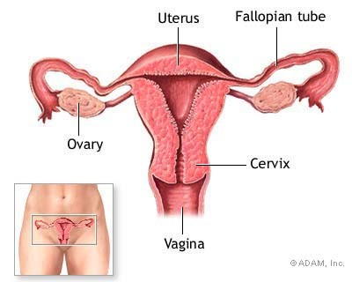
Pelvic Inflammatory Disease (PID)
University of Basrah
Al-Zahraa Medical College
Ministry of higher Education and Scientific Research
Pelvic Inflammatory Disease (PID) is an ascending infection from the endocervix causing:
Endometritis
Salpingitis
Oophoritis
Pelvic peritonitis
+/- tubo ovarian
abscess

Slide 3
Risk Factors ????
University of Basrah
Al-Zahraa Medical College
Ministry of higher Education and Scientific Research

Slide 4
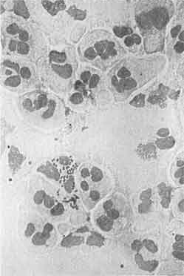
Causative Organisms
University of Basrah
Al-Zahraa Medical College
Ministry of higher Education and Scientific Research
Most cases are polymicrobial, the causative M.O. Of PID:
Nesseria Gonorrhoea
Gram –‘ve intracellular diplococci
Chlamydia Trachomatis
Gram –‘ve obligate intracellular M.O
Bacterial Vaginosis
Anareobes, Enteric Gram –‘ve Bacteroides
Streptococci
Haemophillis Influenzae
Cytomegalovirus
Mycobacterium Tuberculosis
Notes:
1 & 2 are the most common pathogens.

Slide 5
Pathogenesis
Pathogenesis
University of Basrah
Al-Zahraa Medical College
Ministry of higher Education and Scientific Research
Infection of the cervix (endocervicitis) spreads, either directly or via lymphatics to the endometrium, uterine tubes and the pelvic peritoneum.
Peritonitis
Salpingitis/ oophoritis/ tubo-ovarian abscess
Endometritis
Cervicitis

Slide 6
Clinical criteria
Diagnosis
University of Basrah
Al-Zahraa Medical College
Ministry of higher Education and Scientific Research
Abdominal, pelvic pain & dyspareunia
Temperature >38°C
Abnormal cervical mucopurulent discharge.
Heavy/inter-menstrual bleeding
Adenexal, pelvic tenderness &/or cervical motion tenderness (cervical excitation).
Pelvic mass

Slide 7
Classification
Clinical Manifestations
University of Basrah
Al-Zahraa Medical College
Ministry of higher Education and Scientific Research
Overt
40%

Slide 8
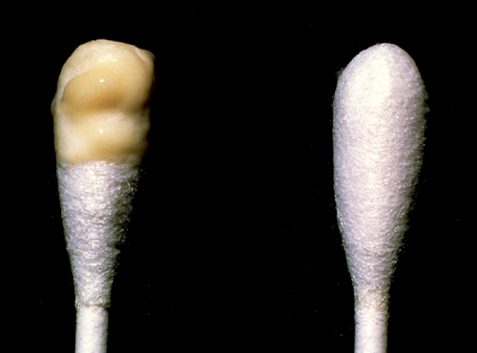
Mucopurulent Cervical Discharge (Positive swab test)
Diagnosis
University of Basrah
Al-Zahraa Medical College
Ministry of higher Education and Scientific Research
Source:Seattle STD/HIV Prevention Training Center at the University
of Washington/ Claire E. Stevens and Ronald E. Roddy

Slide 9
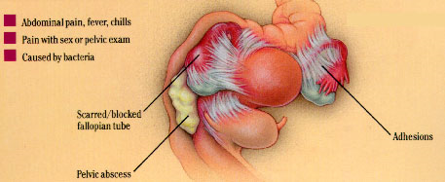
Sequelae of PID
University of Basrah
Al-Zahraa Medical College
Ministry of higher Education and Scientific Research
Immediate
Tubo-ovarian abscess
Pyo-salpinx
Long Term
Ectopic Pregnancy
Tubal infertility
Dyspareunia (Painful
sexual intercourse)
Chronic PID / Chronic pelvic pain
Pelvic adhesions

Slide 10
Chronic Pelvic Inflammatory Disease
University of Basrah
Al-Zahraa Medical College
Ministry of higher Education and Scientific Research
Symptoms > 6 Months Duration
Pelvic pain
Secondary dysmenorrhoea
Deep dyspareunia
Menstrual disturbance
Recurrent acute painful exacerbations

Slide 11
Diagnosis A- Laboratory Investigations of PID
University of Basrah
Al-Zahraa Medical College
Ministry of higher Education and Scientific Research
Pregnancy test
Triple and urethral swabs
High vaginal swab – Bacteria vaginosis organisms
Endocervical swab – Neisseria gonorrhoea
Endocervical swab - Chlamydia trachomatis
Urethral swab – Chlamydia trachomatis (males only)
Midstream Urine
Leucocytes and nitrates
C-Reactive Protein and ESR
Markers for acute infection / inflammation
The presence of leucocytes on vaginal wet preparation.

Slide 12
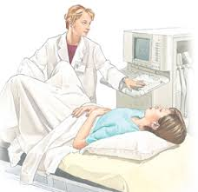
B - Other investigations
Diagnosis
University of Basrah
Al-Zahraa Medical College
Ministry of higher Education and Scientific Research
1. Transvaginal sonography or MRI.
for pelvic mass

Slide 13
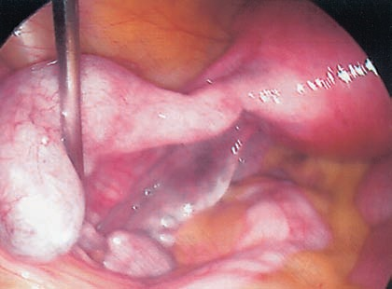
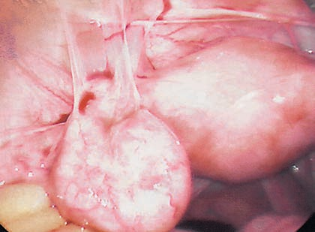
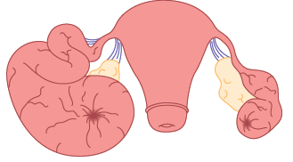
2. Laparoscopy
University of Basrah
Al-Zahraa Medical College
Ministry of higher Education and Scientific Research
a. Left tubal hydrosalpinx
c. Peritubal adhesions
b. Bilateral hydrosalpinx

Slide 14
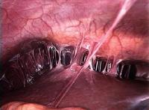
Perihepatic adehesions (Fitz-Hugh-Curtis syndrome)
University of Basrah
Al-Zahraa Medical College
Ministry of higher Education and Scientific Research

Slide 15
Differential Diagnosis
University of Basrah
Al-Zahraa Medical College
Ministry of higher Education and Scientific Research
Ectopic pregnancy
Acute appendicitis
Irritable Bowel Syndrome (IBS)
Ovarian cyst accidents (torsion, rupture, haemorrhage)
Urinary Tract Infection (UTI)
Functional pelvic pain of unknown origin

Slide 16
Treatment
Management
University of Basrah
Al-Zahraa Medical College
Ministry of higher Education and Scientific Research
Regimens must provide coverage of N. gonorrhoeae, C. trachomatis, anaerobes, Gram-negative bacteria, and streptococci.
( A combination of ceftriaxone, doxicycline & metronidazole)
Treatment should be instituted as early as possible to prevent long term sequelae.
In the patient with a pelvic abscess, surgery is warranted. For drainage of abscess+/-salpingo-oopherectomy.

Slide 17
Thank you

